Slide 1
Ion Traps for Partial Pressure Measurement
Carolina Adame

Slide 2

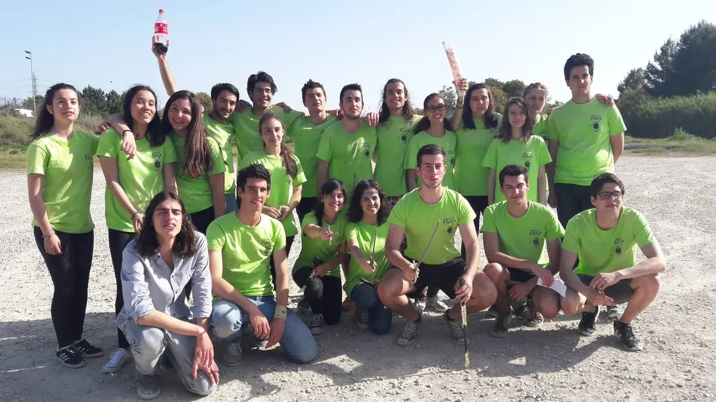
MIEF 2016/17
How do you do, fellow Students?
Ion Traps for Partial Pressure Measurement
?
?
?

Slide 3
Ion traps
What?
A device that uses electromagnetic fields to trap ions.
  RF fields: 2D and 3D quadrupole ion traps or Paul traps;
  Static electric fields + strong magnetic field: Penning traps (FT-ICR);
  Static electric fields: Kindgon trap and Orbitrap.
Why?
  Mass spectrometry
  Precision measurements in fundamental physics
  Metrology
  Quantum computing
Goal: develop an ion trap for residual gas analysis
Notes:
Rapidly switching electric field create a pseudopotential well that traps the ions.
Magnetic field provides radial confinement; electric field provides axial confinement.
Electrostatic fields trap ions in stable orbits.

Slide 4
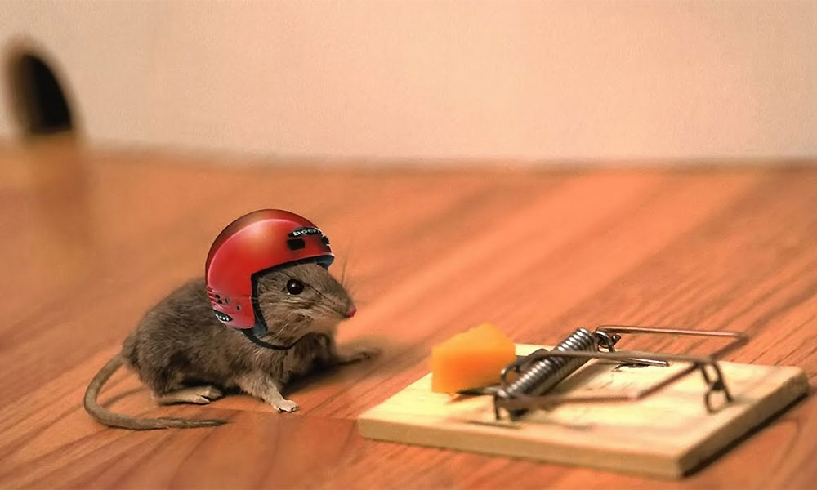

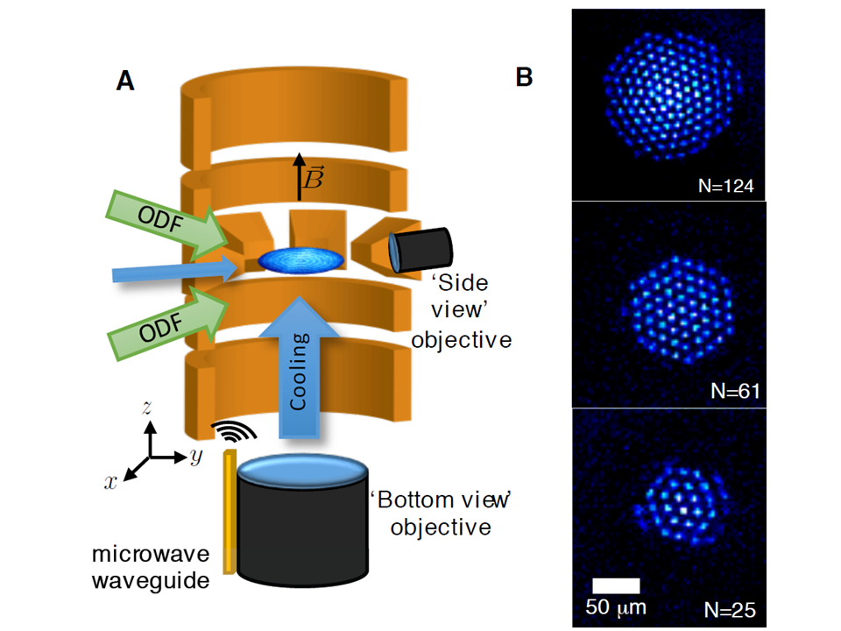
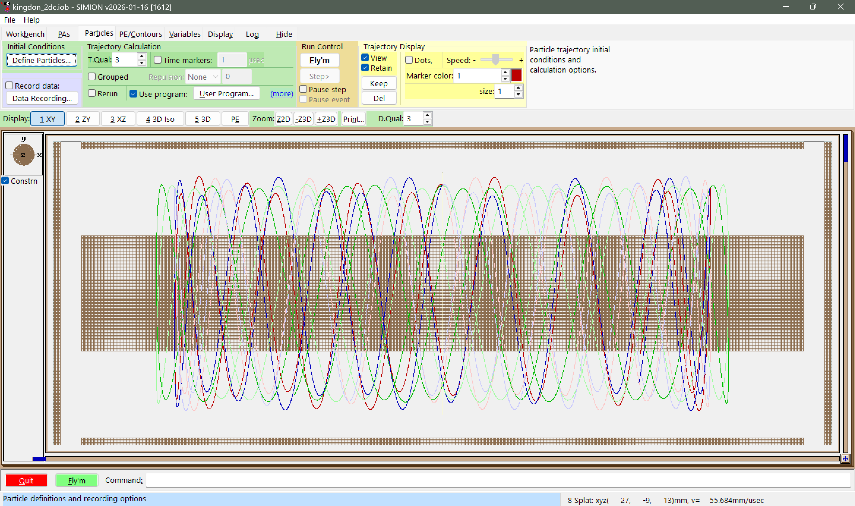
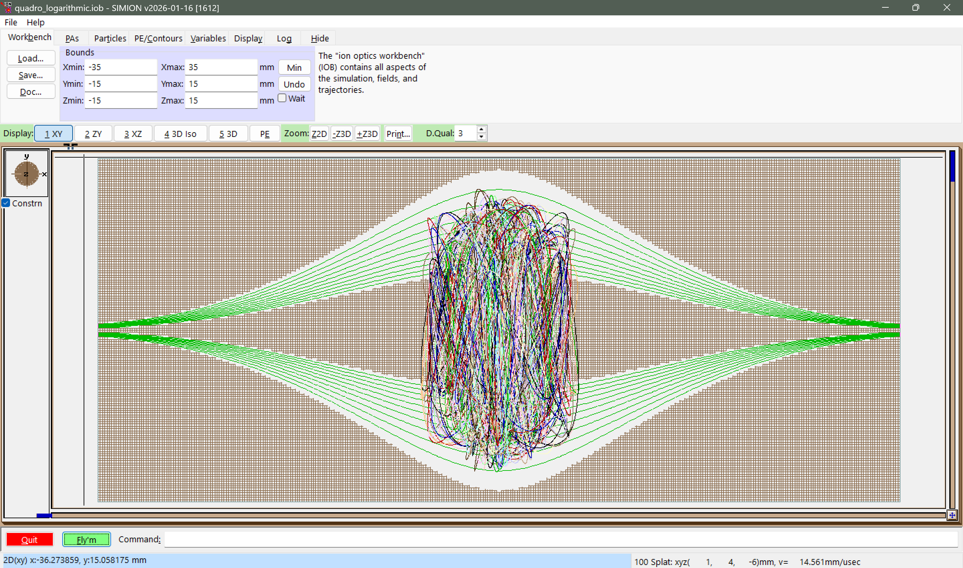
Electrostatic Ion traps?
Earnshaw’s theorem states that “A charged particle cannot be held [statically] in a stable equilibrium by electrostatic forces alone.” (Griffiths, p.115)
"C:\(…)\SIMION-2024\examples\icrcell"
"C:\(…)\SIMION-2024\examples\kingdon_trap"
Notes:
https://www.nist.gov/image/penningtrappng

Slide 5

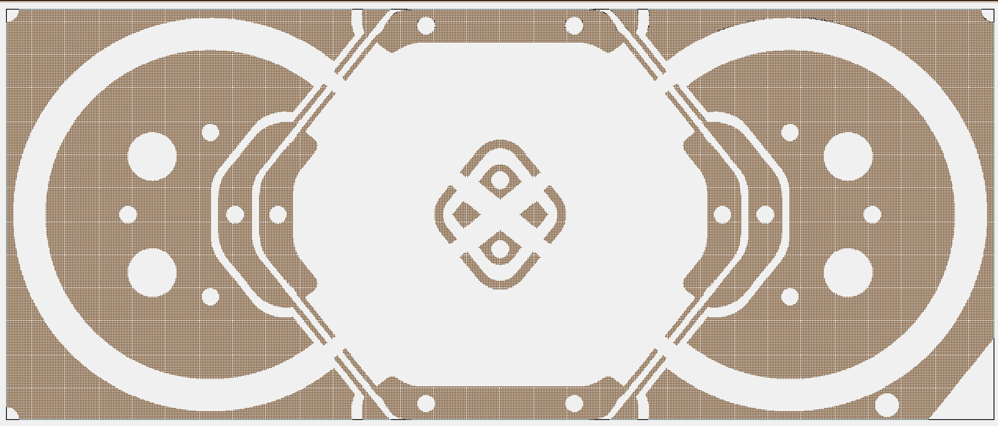

Racetrap – an ion trap for residual gas analysis
-29.52 V
0 V
-12.12 V
-12.12 V
-48.58 V
-48.58 V
  Spatial focusing and Energy focusing

Slide 6
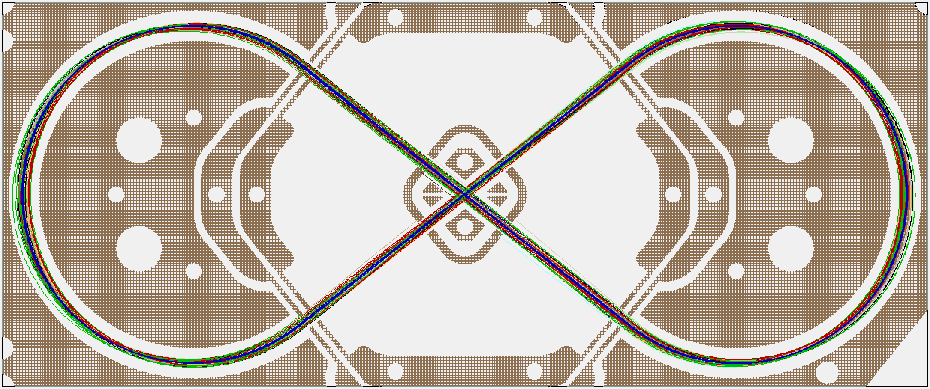
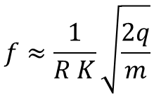
Mass analysis in an ion trap
Ion identity (m/z) is encoded as a frequency of ion oscillations in an ion trap
Frequencies of ion oscillations are measured as time-domain signals - transients
Fourier transform decodes transients to reveal frequencies (m/z) values
$$f≈\frac{1}{R K}\sqrt{\frac{2q}{m}}$$

Slide 7
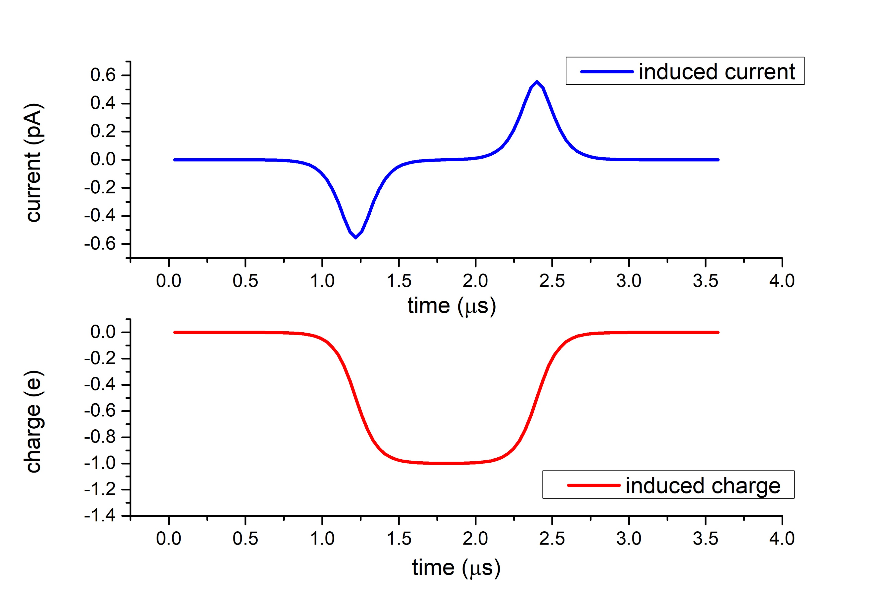
Image Charge Detection
When a bunch of ions cross the electrode region, a pulse of induced charge is generated, with a time width determined by the transit time of ions.
The induced charge is of the same order as the total charge of the ion bunch.
current
charge
Some applications:
Beam diagnostics in particle accelerators
Ion Traps (Orbitrap, FT-ICR)
Charge Detection Mass Spectrometry
SIMION simulation of the charge and current induced by a positive ion crossing a ring electrode
https://simion.com/info/image_charge_detection.html
Notes:
How induced charge detection works: written In the slide
This is a simulation using SIMION of the induced current and charge on an electrode when a positive ion crosses it. There is a current peak when the charges move around to counteract the electric field induced by the ion, and then another peak when it leaves. And here is the corresponding pulse of charge (negative).
Image charge detection, also called induced charge detection is used in many fields, such as:
Particle and Beam Diagnostics (Accelerators) Beam Position Monitors (BPMs) and Wall Current Monitors: Non-destructive measurement of beam intensity, position, and bunch shape
Charge Detection Mass Spectrometry Detects individual ions or macromolecules with many charged states
Ion Traps (Orbitrap, FT-ICR) Allows precise measurement of mass-to-charge ratio and oscillation frequency
One thing to consider is that we can detect the variations of charge inside the electrode, so it would not work with a continuous beam. So we must modulate the ion current. And modulating the current allows us to use a lock in amplifier.

Slide 8
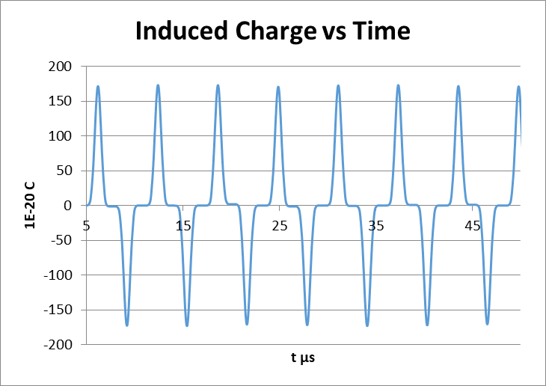
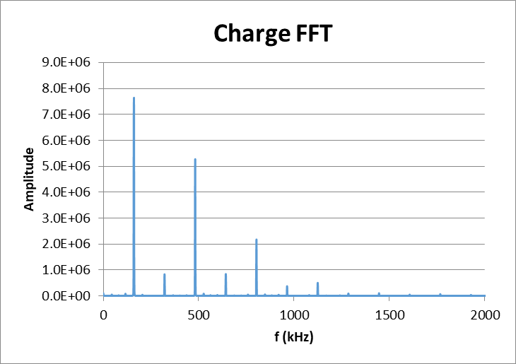

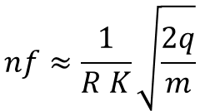
Mass analysis in an ion trap
Ion identity (m/z) is encoded as a frequency of ion oscillations in an ion trap
Frequencies of ion oscillations are measured as time-domain signals - transients
Fourier transform decodes transients to reveal frequencies (m/z) values
$$nf≈\frac{1}{R K}\sqrt{\frac{2q}{m}}$$
Another benefit of non-destructive detection is that we can measure the ion signal decay due to collisions with residual gas

Slide 9


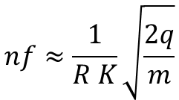
Image charge simulations in SIMION
$$nf≈\frac{1}{R K}\sqrt{\frac{2q}{m}}$$
"C:\(…)\SIMION-2024\examples\electrostatic_induction"
m=28

Slide 10
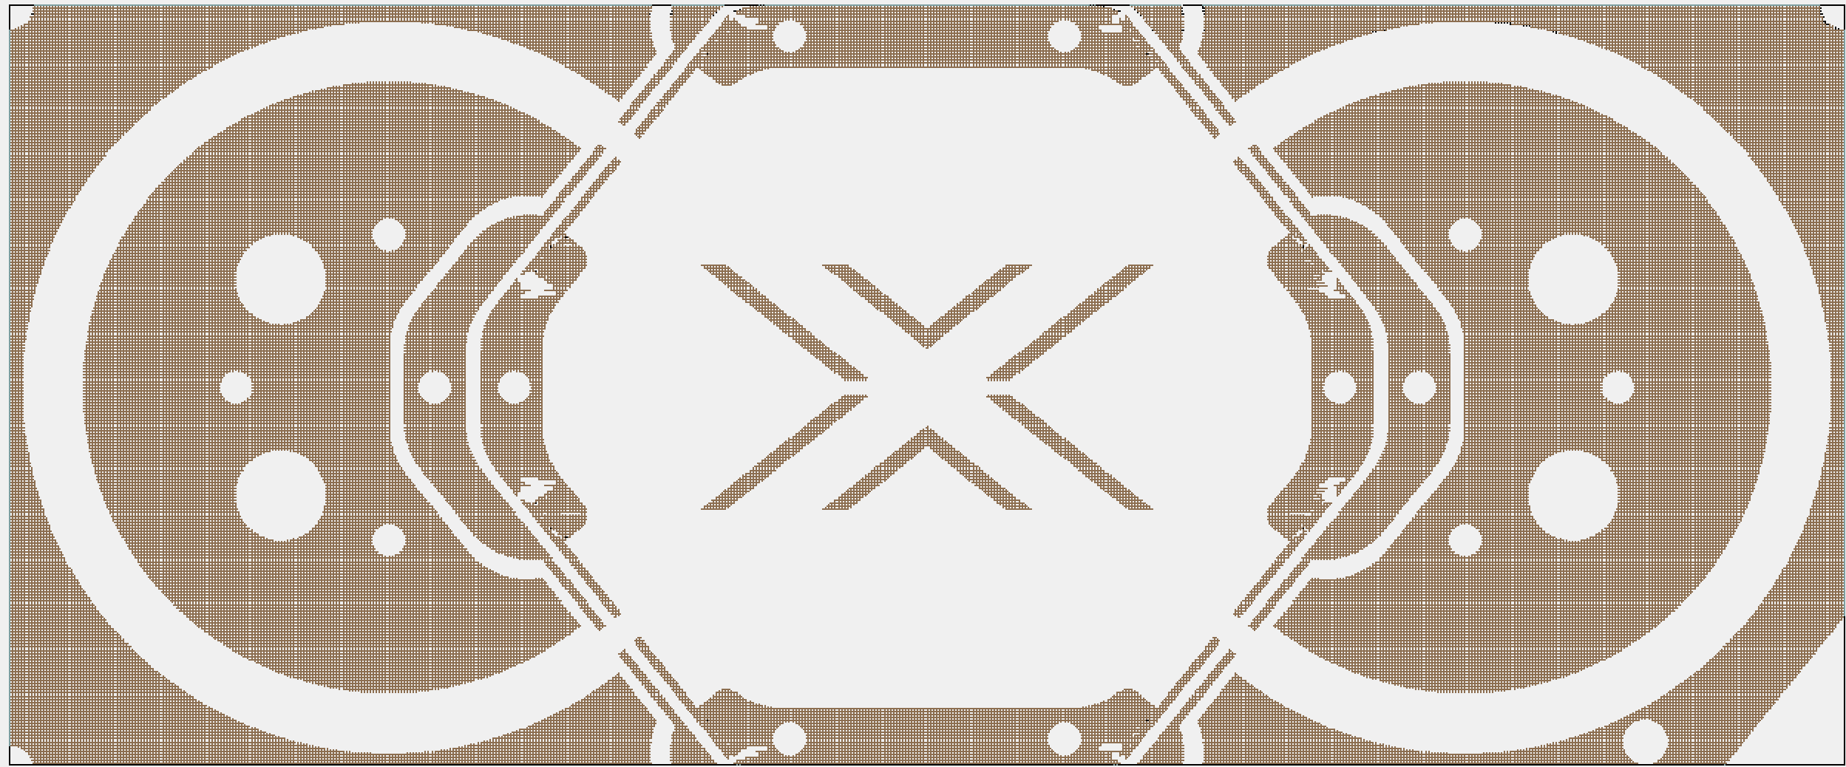
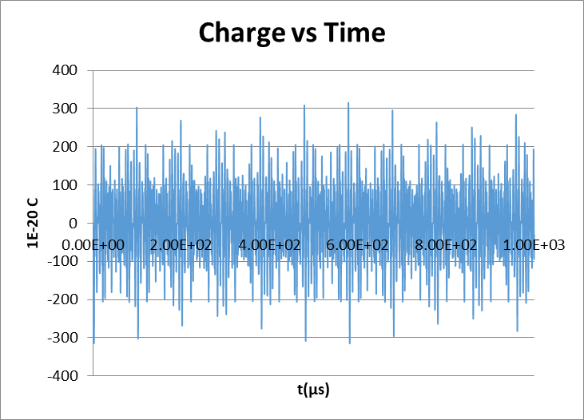
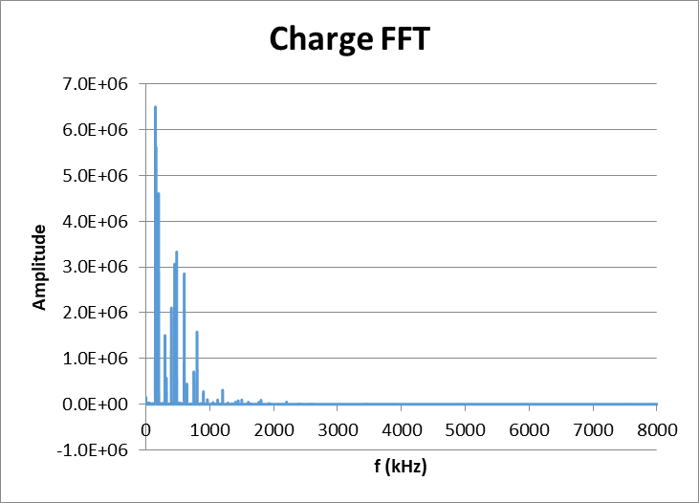
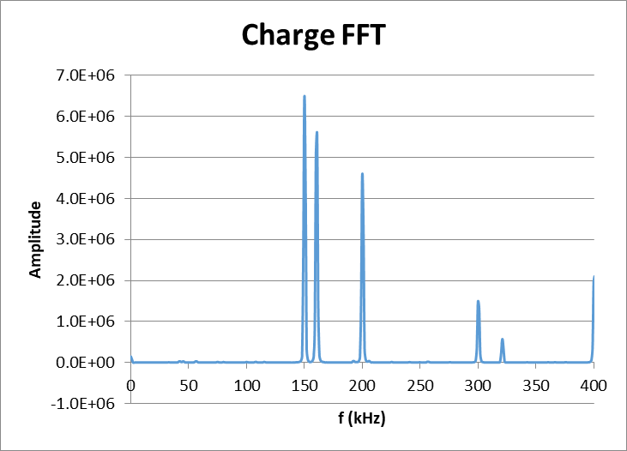
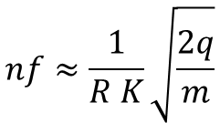
Image charge simulations in SIMION
$$nf≈\frac{1}{R K}\sqrt{\frac{2q}{m}}$$
"C:\(…)\SIMION-2024\examples\electrostatic_induction"
H 1: 150.000 kHz area = 1.335e+07 (19.54%)
H 2: 161.000 kHz area = 1.243e+07 (18.19%)
H 3: 200.000 kHz area = 9.599e+06 (14.05%)
N₂ + H₂O + O₂
N₂
O₂
H₂O

Slide 11
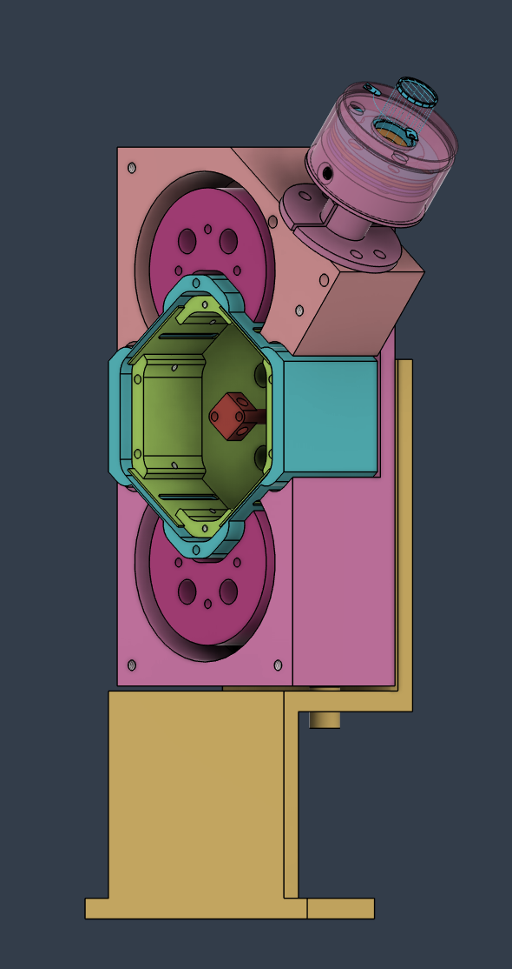
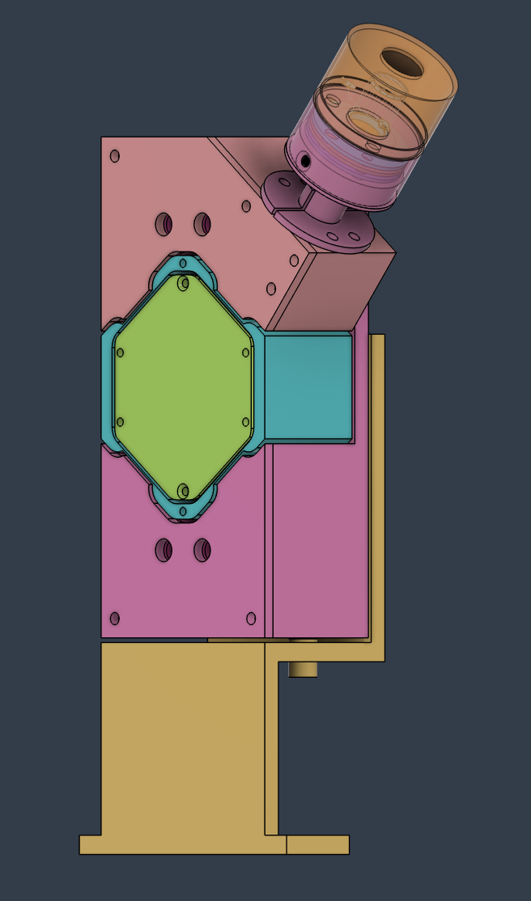
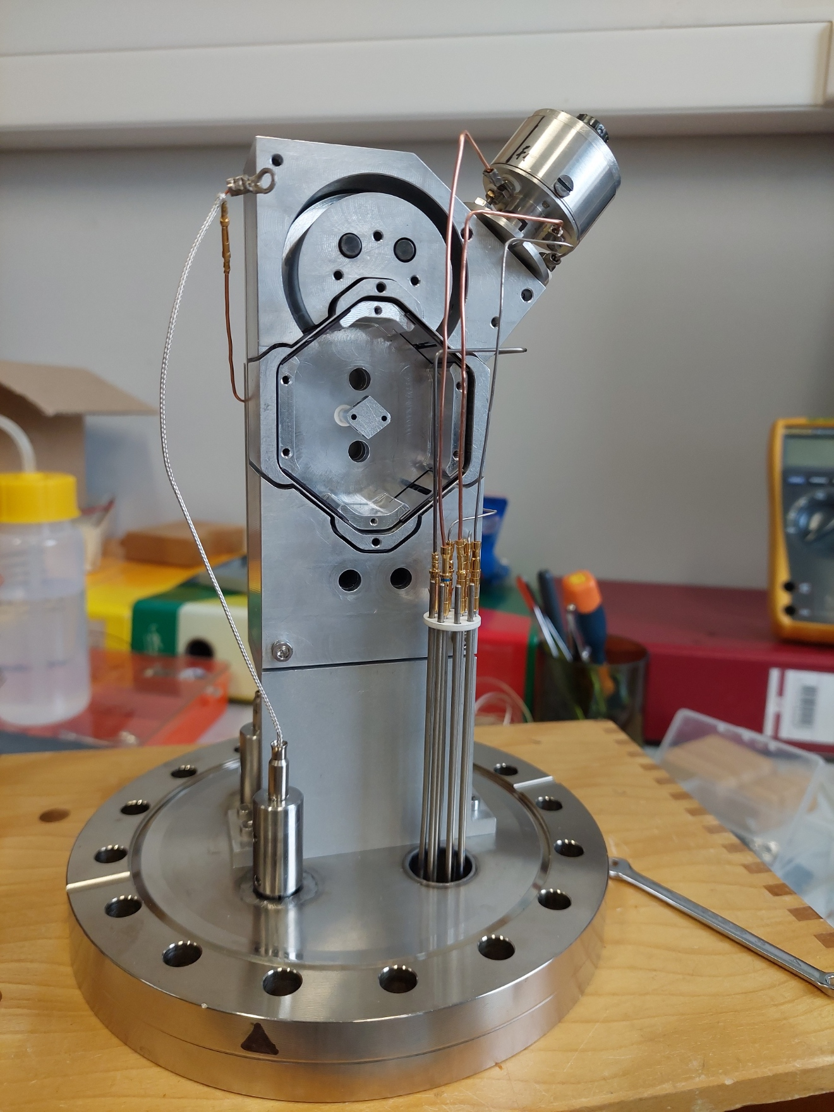
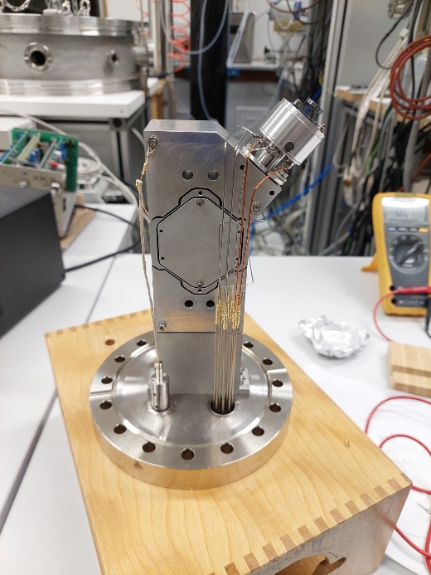
Questions?

